Slide 1
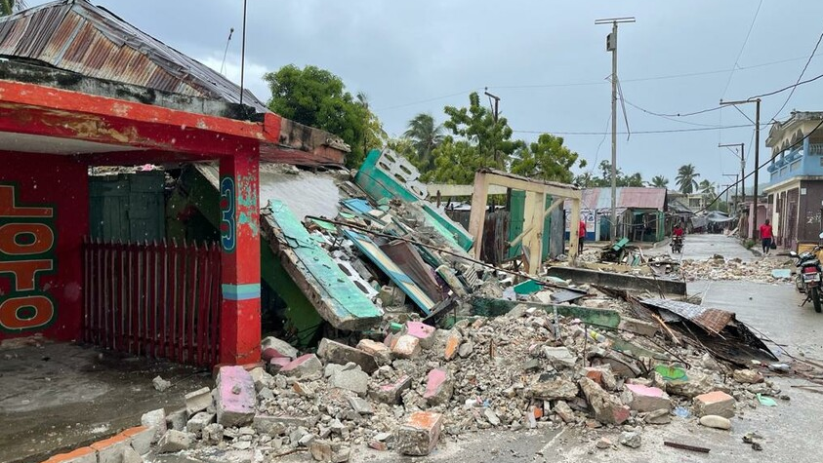
Allison Shelley for LWR
lwr.org/GiveHaiti
Notes:
A devastating 7.2 magnitude earthquake struck our neighbors in Haiti on August 14 – a brutal blow to this impoverished country still recovering from the disastrous 2010 quake and fighting a surge of coronavirus infections. Roads are inaccessible throughout many regions of the country.

Slide 2
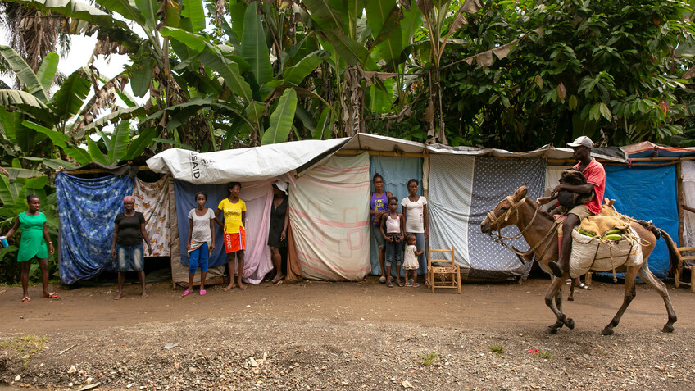
Allison Shelley for LWR
lwr.org/GiveHaiti
Notes:
Families stand in front of their makeshift dwellings, tent-sized shelters made of tarps and wood, along the side of the road near Chambellan, in the Grand’Anse department of Haiti, one week after the earthquake that destroyed their homes.

Slide 3
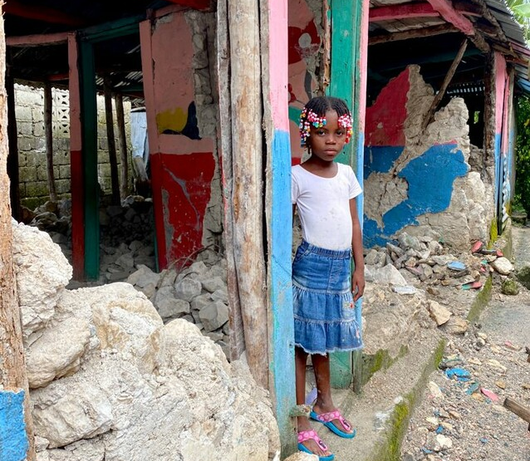
Allison Shelley for LWR
lwr.org/GiveHaiti
Notes:
Onella Michel, 6, stands in the ruins of her school in Chamberllan, Haiti, one week after the 7.2 earthquake that devasted much of the region. “I was trembling,” said Onella of that day. She escaped harm by the quick action of her mother, who grabbed her hand and ran her to the street as soon as the shaking began.

Slide 4
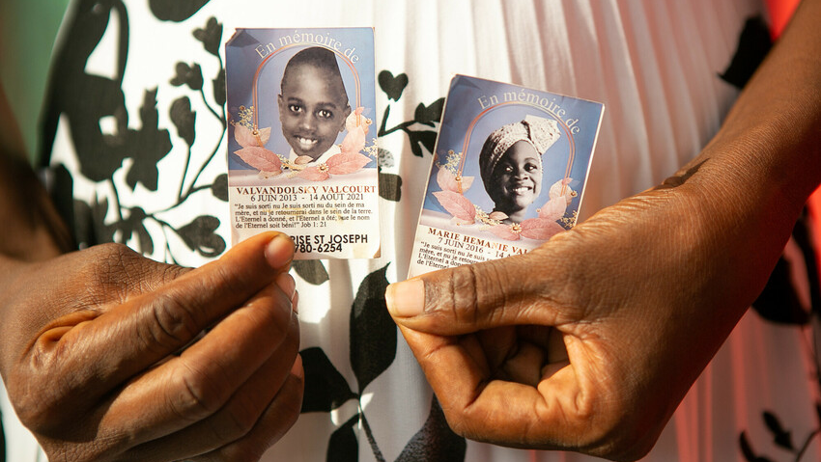
Allison Shelley for LWR
lwr.org/GiveHaiti
Notes:
Marie Entonnance Dely, 45, holds photos of her nephew Valvandolsky Valcourt, 8 and Marie Hemanie Valcourt, 5, who were killed when their home in downtown Jeremie, Haiti collapsed in the August 14 earthquake. The two had been playing video games on the couch. Dely says that it took over three hours to dig them out and that passersby were more interested in looting the grocery depot next door than helping.

Slide 5
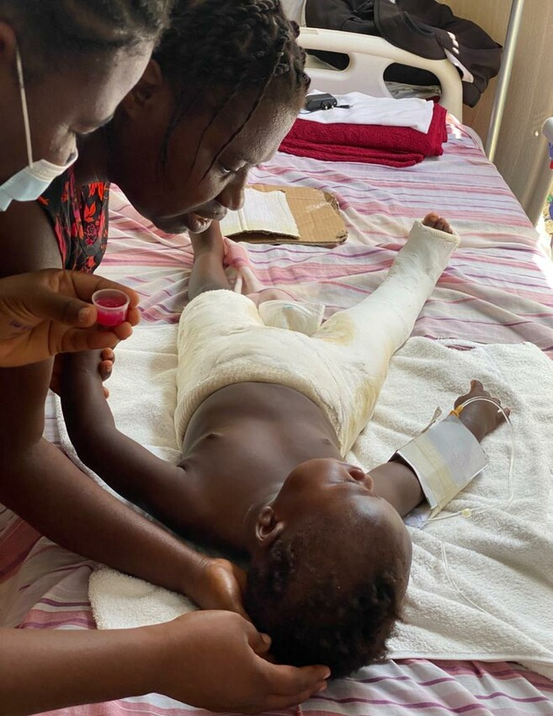
Allison Shelley for LWR
lwr.org/GiveHaiti
Notes:
Islande Joseph helps a nurse administer medication to her son Evenson Dorvil, 22 months, at St. Antoine Hospital in Jeremie, Haiti. Evenson suffered extensive injuries, including a complete fracture to his right leg, when a wall of the family home fell on him during the earthquake. The house was totally destroyed.

Slide 6
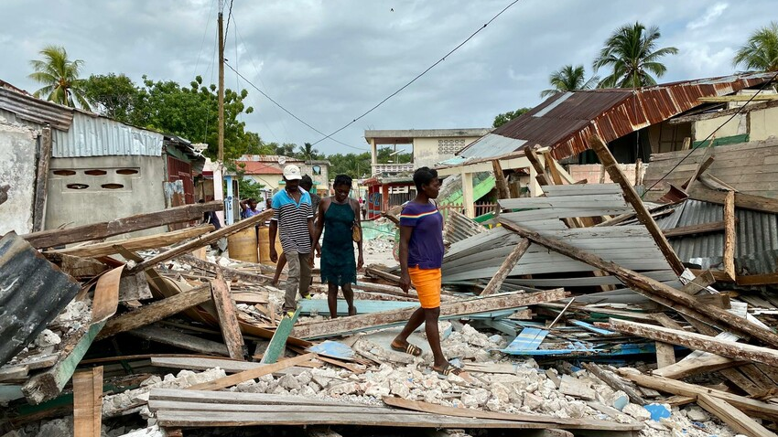
Allison Shelley for LWR
lwr.org/GiveHaiti
Notes:
Your love can make a difference and bring hope to our most vulnerable neighbors. Please make a gift today at lwr.org/GiveHaiti and let our must vulnerable neighbors know that Lutherans in the United States care for them.

